Slide 1
APHA Regional Club Advisory Committee
2019 Officer and Board member Webinar

Slide 2
Agenda
What is the Regional Club Advisory Committee
Regional Club Best Practices
Effective Regional Club Committees
What Can the Regional Club Advisory Committee do for you?
- Open Discussion
- Regional Club Success Stories

Slide 3
What is the Regional Club advisory Committee
Committee Objectives
Utilize, Educate, & Stimulate Regional Clubs
Promote and Guide Regional Clubs
Initiate Dialogue with Regional Clubs
Develop and Implement Strategies to Promote Member Participation

Slide 4
APHA Compliance
Regional Clubs By-laws
Regional Clubs must revise/amend their By-Laws as per the five-year review.
Suggested By-Law outlines are available at APHA.com
APHA Club Mandatory Procedures
Hold an Annual Election of Officer and Directors, the results of which must be submitted to APHA by January 1st EACH YEAR.
Indicate date and set forth notifications of scheduled annual meetings.
Require the Treasurer to present a financial report at all meetings and prepare an annual budget and/or year-to-date financial report to all members accounting for all funds generated by the club.
Establish rules for year-end point tabulation and awards.

Slide 5
APHA Compliance
Maintaining APHA Compliance
The Regional Club Charter will Automatically be renewed when:
Maintain Membership of 20 members, 10 of which must be APHA members
All Officers and Board Members must maintain current APHA Membership during their Term.
Submit a list of Club members to APHA, the Club’s By-laws, and the previous year’s financial statement listing all income and expenditures by MAY 1st of each year.
Each APHA Regional Club must provide a minimum of 2 club approved or sponsored shows or trail rides, or APHA-approved horse or specialty show, participate in a parade or equine-related trade show booth, or host a Paint for a Day or other APHA Approved program activity per year.

Slide 6
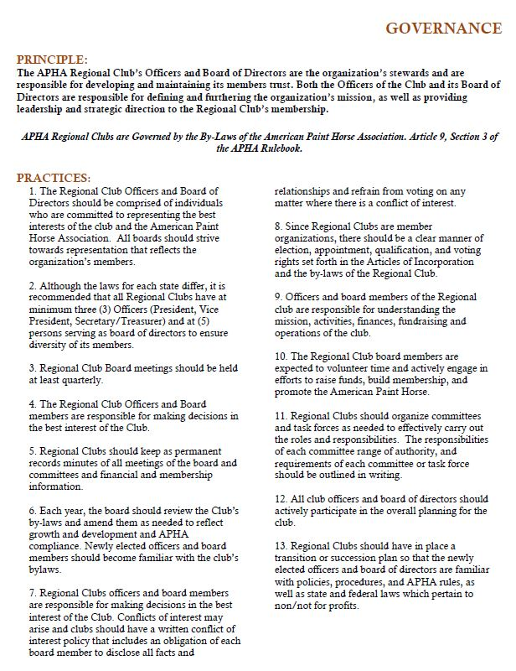

Slide 7
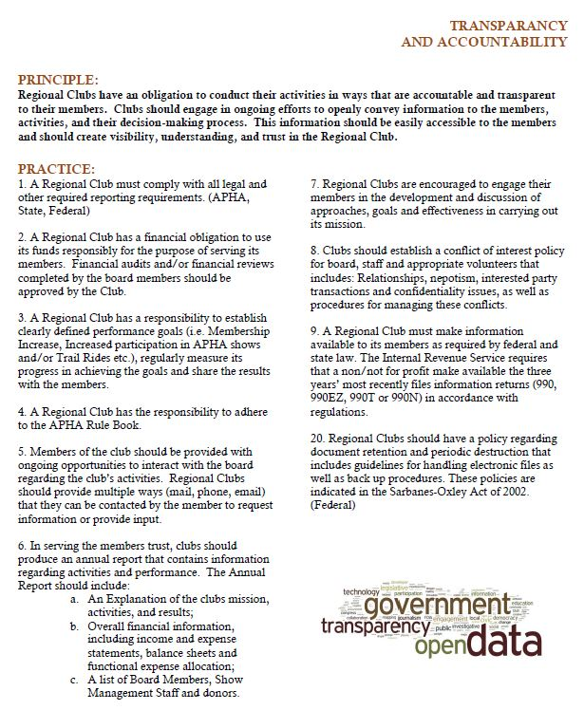

Slide 8
What can we do for your
APHA Regional Club?

